Slide 1
Business Metadata (BMD) Generator UI
Problem Statement
While an ML-based backend solution for generating business metadata (such as PG code, confidentiality classification, etc.) was in place, there was no unified user interface for:
Uploading raw metadata inputs (like dataset descriptions).
Triggering the metadata generation pipeline.
Reviewing, editing, or downloading the generated BMD in a structured format. This led to:
Dependence on backend teams for every generation.
Limited accessibility for non-technical users or data owners.
Lack of transparency and validation during metadata generation.
TMD Generator
BMD Generator
PST Generator

Slide 2
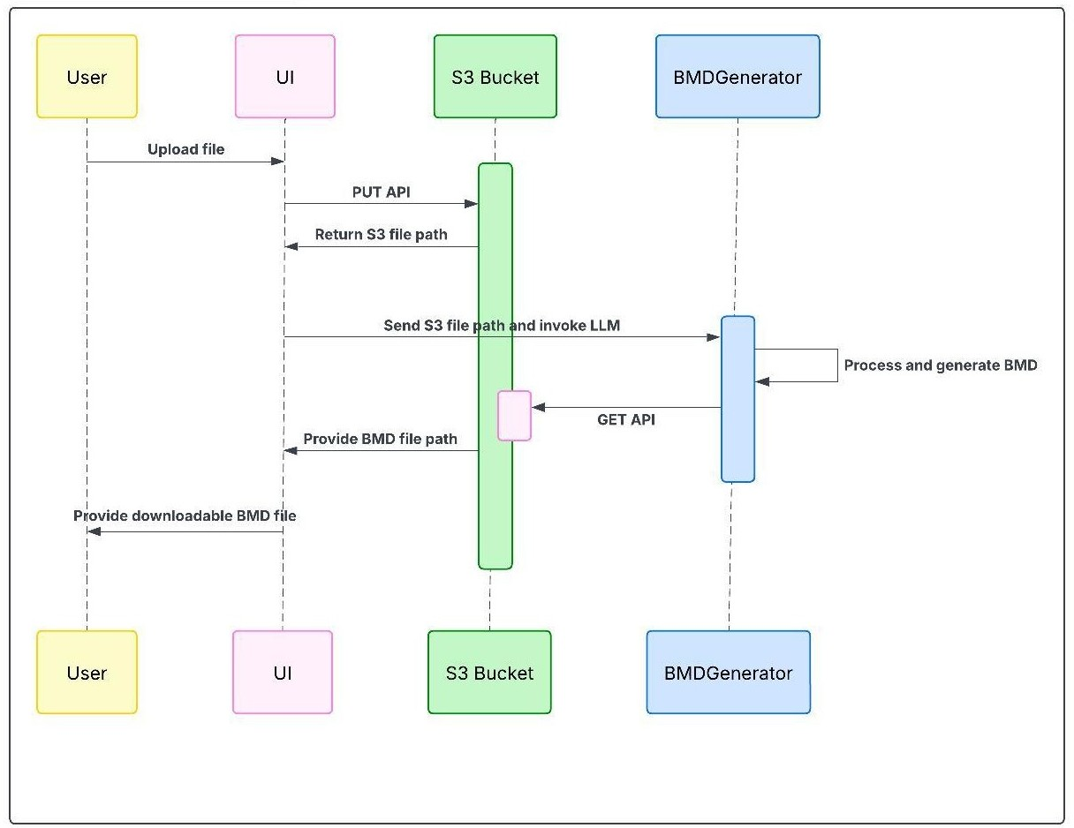
Proposed Solution
Developed a frontend UI for the BMD Generator that:
Allows users to upload metadata input
Triggers backend LLM/NLP-powered generation of business metadata fields (Confidentiality, PG code, etc.).
Displays the generated metadata in a user-friendly, editable table.
This UI:
Bridges the gap between users and the metadata generation engine.
Enables end-to-end ownership for business users.
Streamlines the process and enhances adoption of automated metadata generation.
Impact
Reduced dependency on engineering teams for BMD generation.
Enhanced user accessibility and visibility.
Saved ~3 days of manual effort per dataset, aligning with the efficiency gains from the ML backend.

